Slide 1

VTG capacity of EVs in the Netherlands
25-01-2022

Slide 2
Table of contents
The following will be discussed during this presentation:
Discussion of inputs
Model demonstration
Discussion of results
09-10-2020

Slide 3
Discussion of the inputs

Slide 4
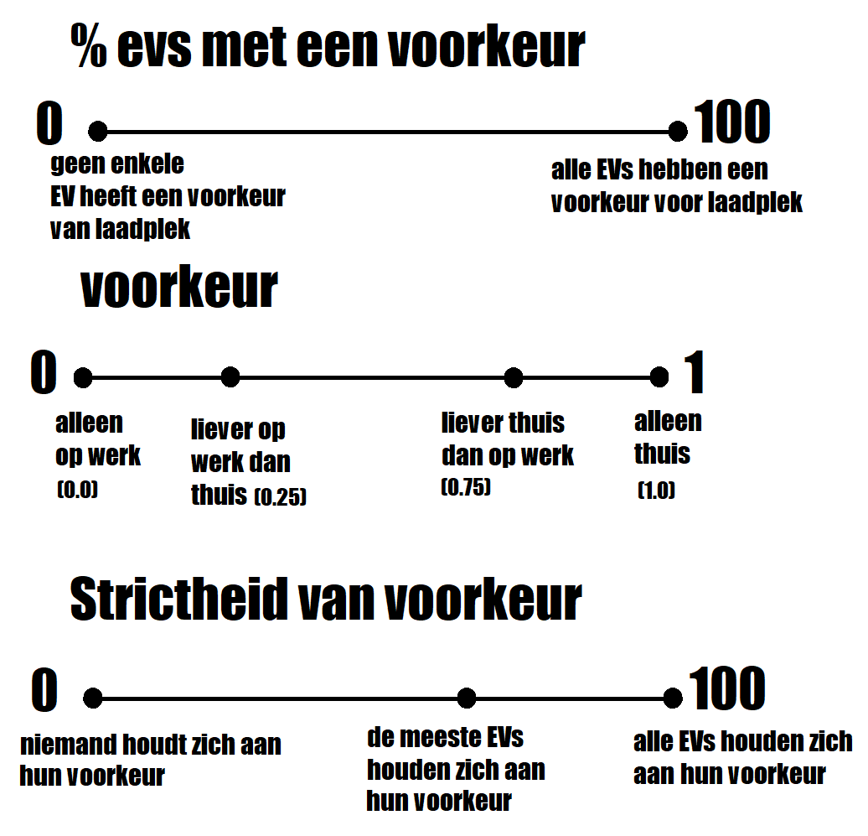
Three input variables for ETM
Total runs = 11 * 11 * 4 = 484 runs
Computation took 2 days on three separate virtual machines.
Estimated costs by microsoft azure ~ € 36
Simulated 174 000 EVs
09-10-2020

Slide 5
Model demonstration

Slide 6
Model demonstration
Run the model in visual studio code.
Code of the model here
Animation of the model in action
09-10-2020

Slide 7
Model Animation
In this GIF the VTG capacity is shown on the left side. The right side shows the total power demand. This visualization was created with 1000 EVs and 50% smart and can be seen below:
09-10-2020

Slide 8
Discussion of the results

Slide 9
Analysis
To test the model’s behavior, we did a number of analysis:
Verification by unit tests
Sobol – sensitivity analysis
Pairplots of outputs
09-10-2020

Slide 10
Unit testing
Unit tests were conducted to test the model’s internal consistency Sobol – sensitivity analysis
21 unit test were made and passed
The tests were used to test the behavior of individual EV’s or model components.
Examples of things that were tested:
Range of EV’s should not exceed a certain level.
EV’s should leave when it’s departure time
EV’s should discharge when driving
EV’s should charge when the battery is too low to depart.
09-10-2020

Slide 11
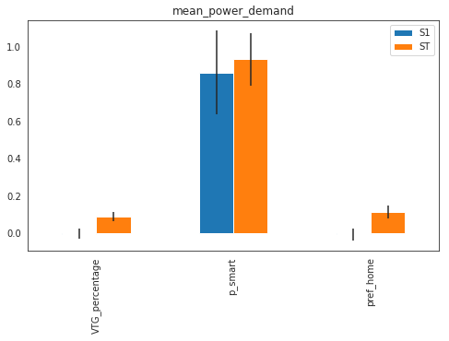
Sobol analysis
Sobol sensitivity analysis was conducted to test the model sensitivity to input variation.
A variation in the amount of smart charging cars changes the mean power demand most significantly.
09-10-2020

Slide 12
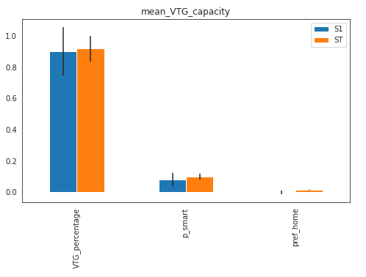
Sobol analysis
A variation in the VTG percentage changed the mean VTG capacity most significantly.
09-10-2020

Slide 13
Pairplots
A pairplot of the model was constructed to see how the model’s variables relate.
09-10-2020

Slide 14
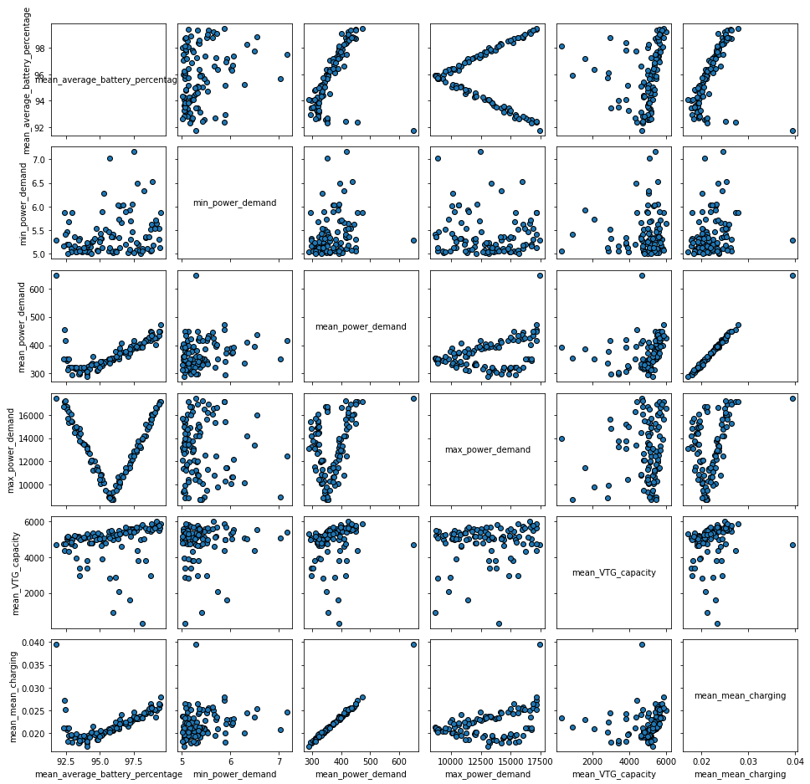
09-10-2020

Slide 15
Results
The runs/profiles generated for the ETM were plotted in graphs. We will discuss the following output variabels:
The VTG capacity
Mean battery percentage
Power demand
09-10-2020

Slide 16
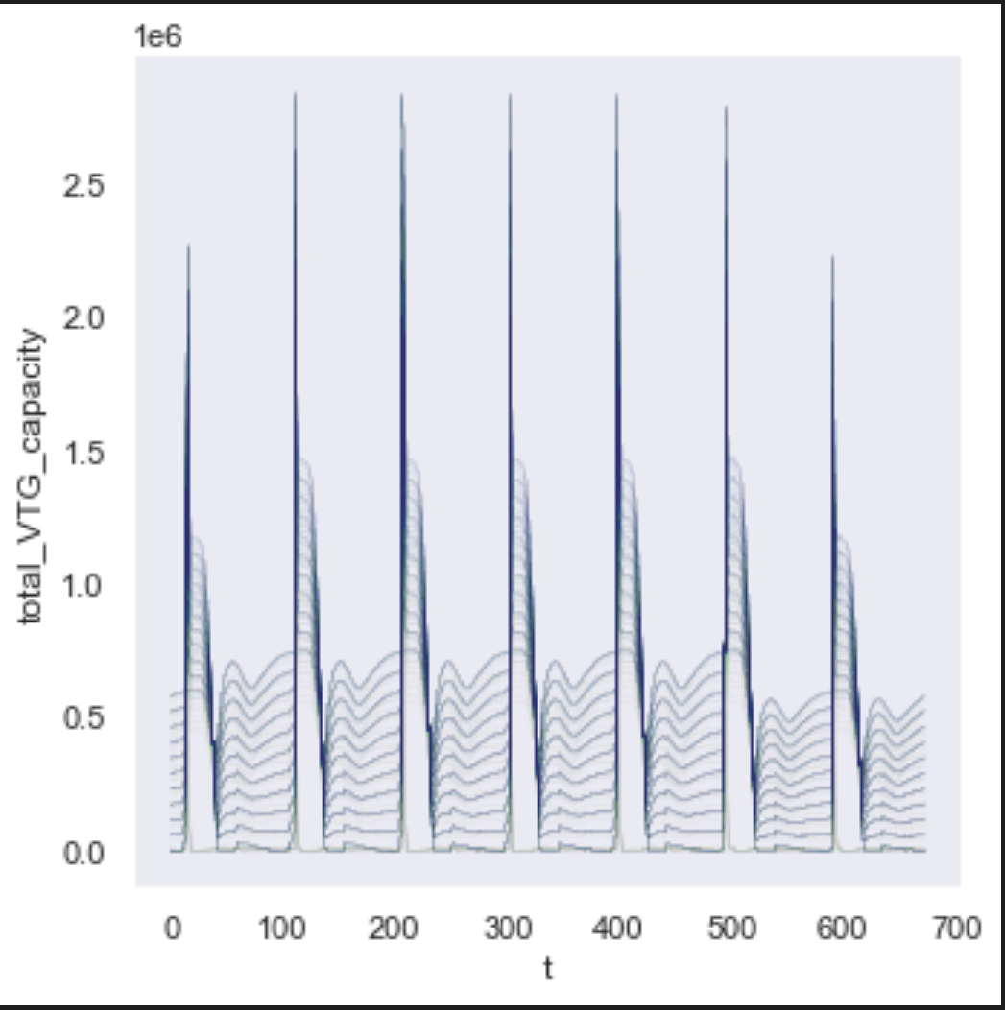
VTG capacity over time.
The following figure shows the VTG capacity of all 484 runs in one picture. The time simulated in this picture was 7 days. The simulation had a warmup time of a week.
09-10-2020

Slide 17
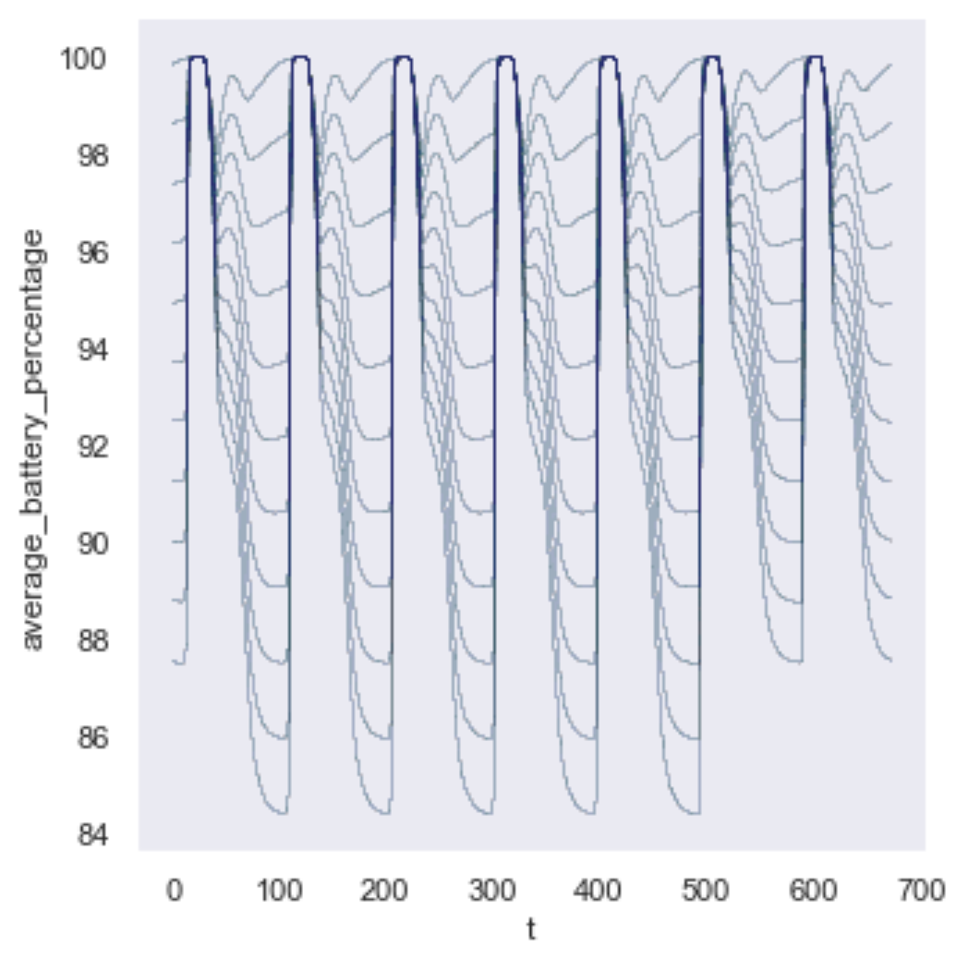
Average battery percentage over time.
The following figure shows the average battery percentage of all 484 runs in one picture. The time simulated in this picture was 7 days. The simulation had a warmup time of a week.
09-10-2020

Slide 18
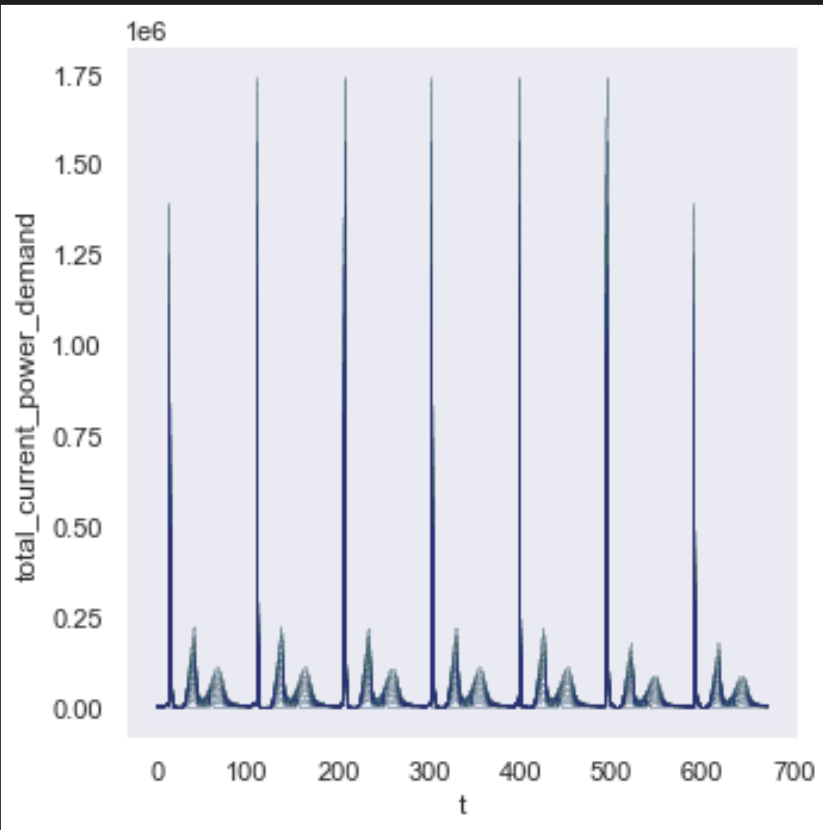
Current power demand over time.
The following figure shows the current power demand of all 484 runs in one picture. The time simulated in this picture was 7 days. The simulation had a warmup time of a week.
09-10-2020

Slide 19
Bedankt voor uw aandacht
25-01-2022

